Slide 1
Getting Your Just “Desserts”

Slide 2
Instructions:
You will be given a description of the dessert
You will be given a picture of the dessert
Guess the dessert as soon as you know it

Slide 3
This traditional Greek pastry is made with phyllo dough, filled with nuts and held together with honey.

Slide 4
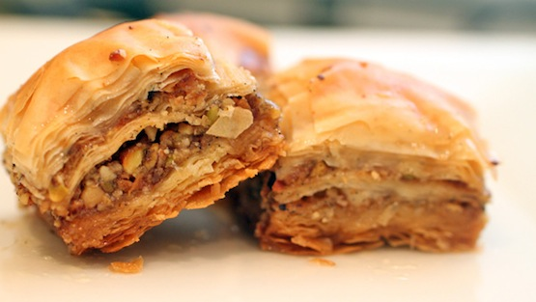

Slide 5
Baklava

Slide 6
This Italian dessert is made with expresso coffee and ladyfingers.

Slide 7
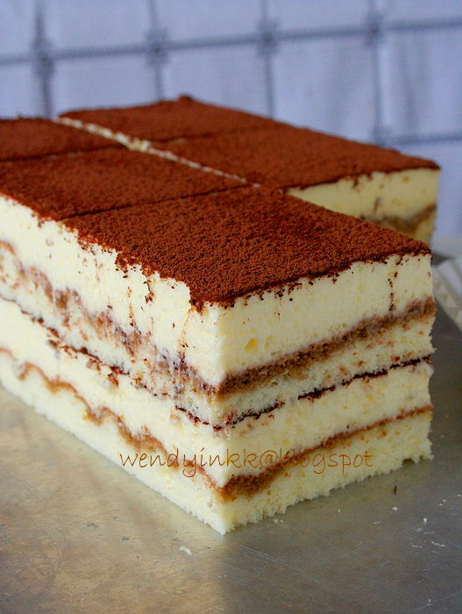

Slide 8
Tiramisu

Slide 9
This dessert ,often served in Spain or Mexico, is made of custard with a caramel topping and baked in a metal band.

Slide 10
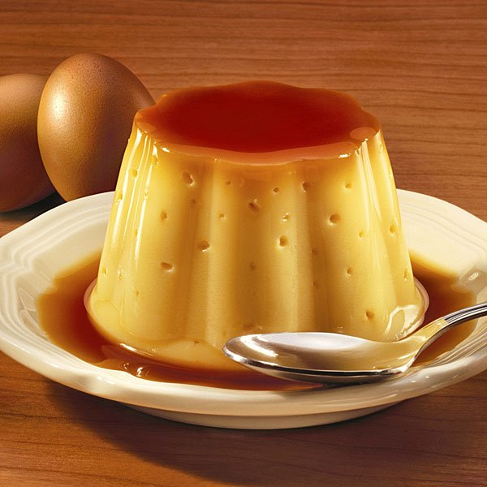

Slide 11
Flan

Slide 12
This German Christmas cookie is usually honey flavored, somewhat resembling gingerbread.

Slide 13
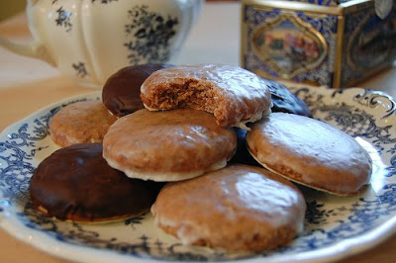

Slide 14
Lebkuchen

Slide 15
This dense and chewy cookie with coconut is eaten by many Jewish families during Passover.

Slide 16
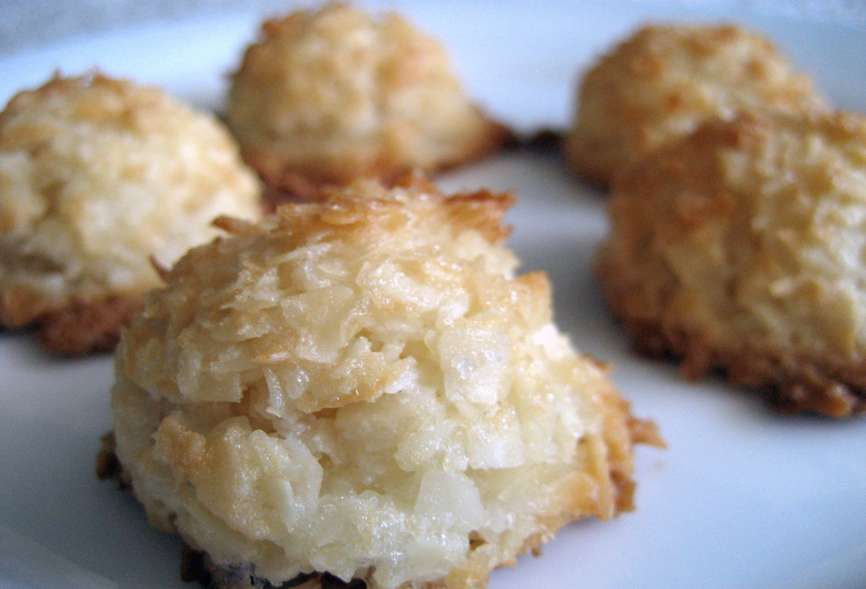

Slide 17
Macaroon

Slide 18
This versatile baked pudding is made in the French countryside.

Slide 19
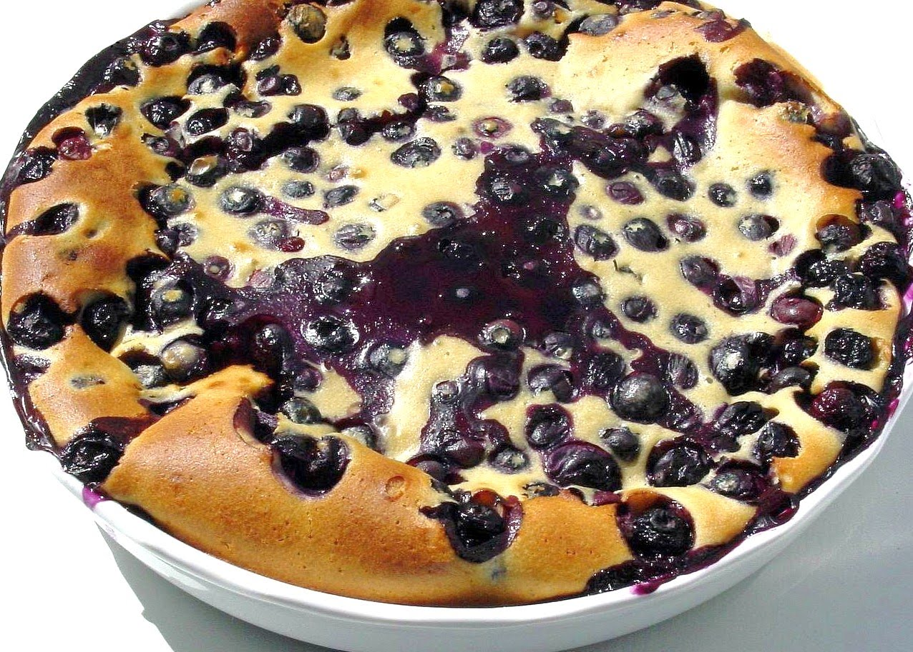

Slide 20
Clafouti

Slide 21
This rich dessert was originally eaten by the poor in England to make use of stale bread.

Slide 22
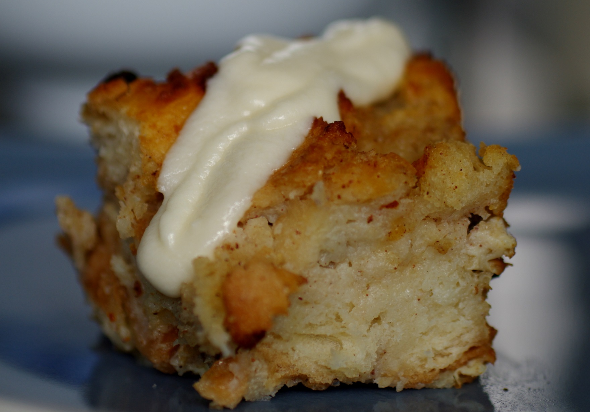

Slide 23
Bread Pudding

Slide 24
This rich Italian ice cream is typically made with fresh fruit.

Slide 25
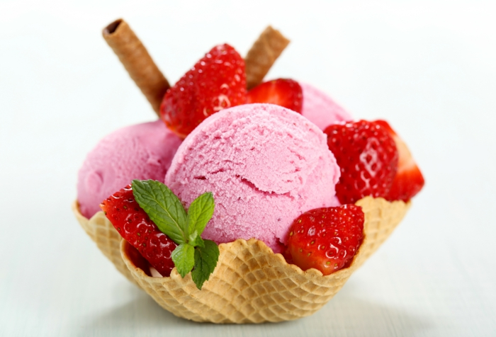

Slide 26
Gelato

Slide 27
This American classic is made with sugar, cinnamon and a pastry crust often topped “a la mode” or with a cheddar slice.

Slide 28
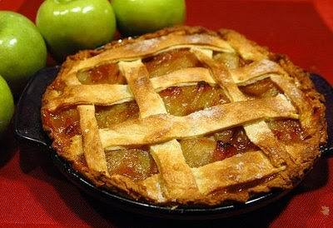

Slide 29
Apple pie

Slide 30
This traditional Australian cookie is named for the Australian-New Zealand Army Corps.

Slide 31
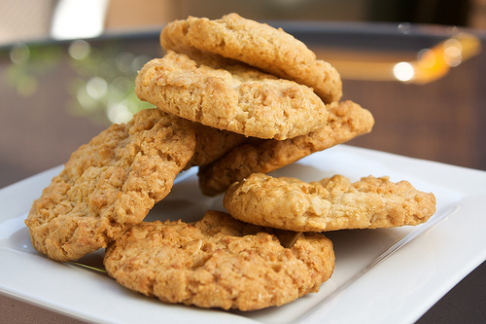

Slide 32
Anzac biscuits

Slide 33
These Mexican sugar cookies are usually enjoyed on special occasions and commonly served with hot chocolate

Slide 34
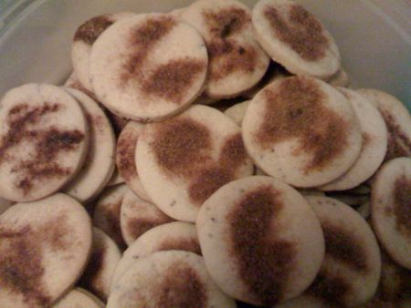

Slide 35
Biscochitos

Slide 36
This German sweet coffee cake is made with fruit and nuts.

Slide 37
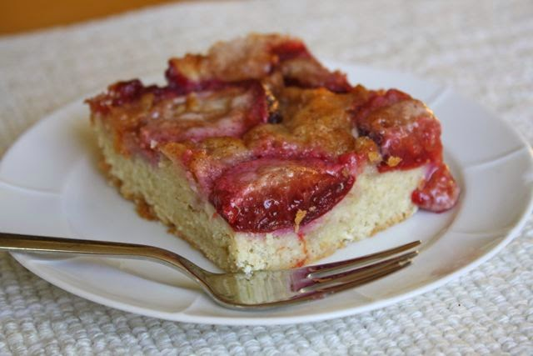

Slide 38
Kuchen

Slide 39
This Jewish cookie is shaped like a crescent and may be filled with raisins, walnuts and other fruits in a cream cheese dough.

Slide 40
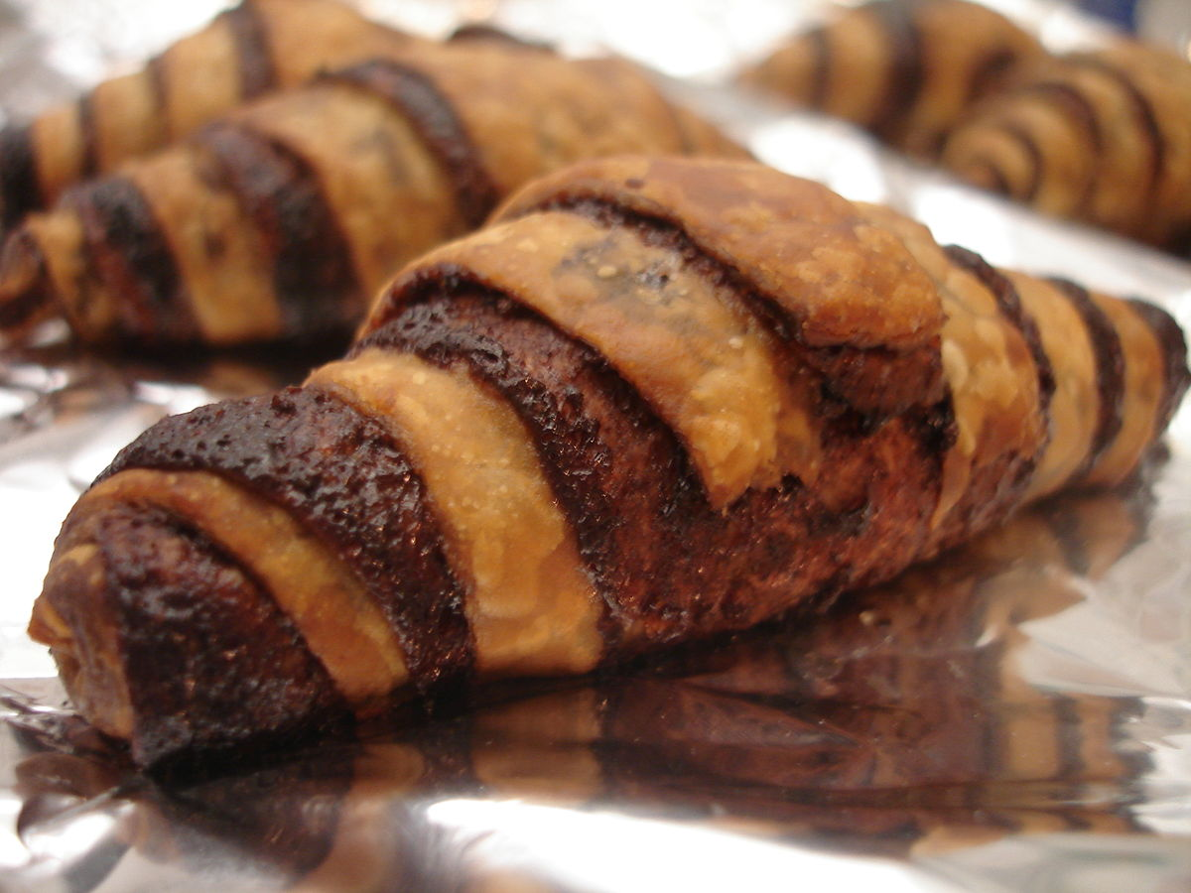

Slide 41
Ragelach

Slide 42
These dense Italian cookies are used for dipping into your favorite coffee.

Slide 43
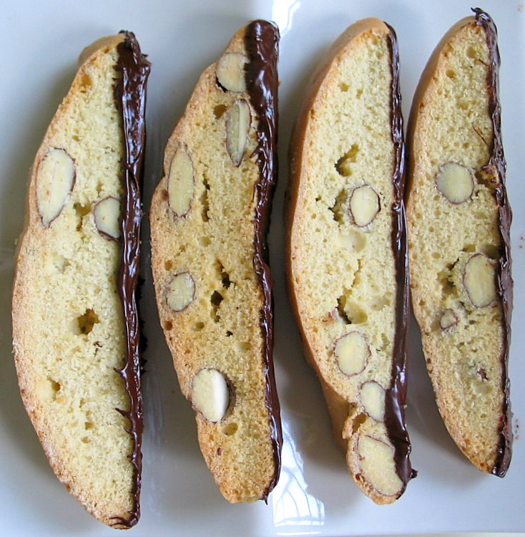

Slide 44
Biscotti

Slide 45
This meringue-style dessert is named after a Russian dancer but eaten in Australia and New Zealand.

Slide 46
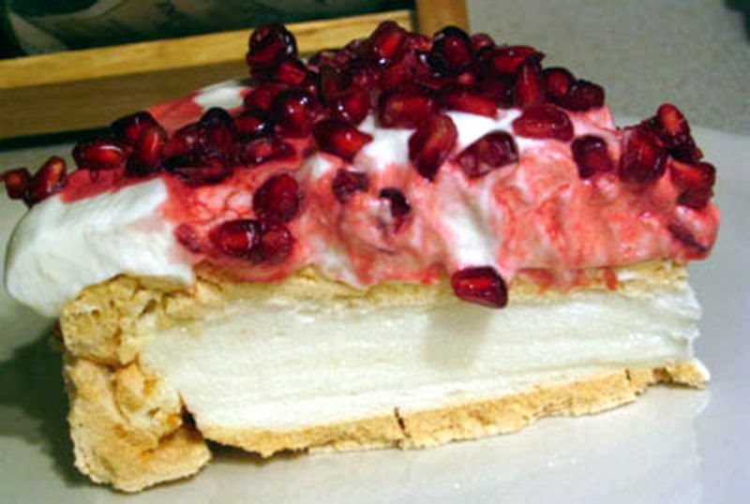

Slide 47
Pavlova

Slide 48
A favorite dessert all over France. It contains rich, creamy custard topped with a layer of hard, crunchy caramel that is slightly browned.

Slide 49
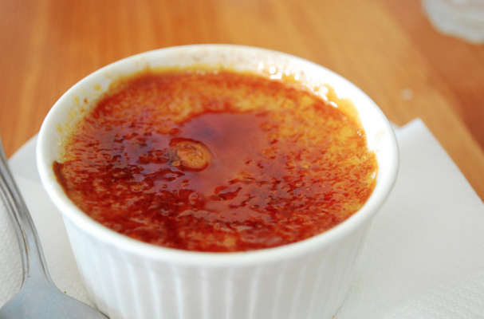

Slide 50
Crème brulee

Slide 51
Commonly eaten on Argentine Independence Day, these flaky puff pastries are filled with sweet potato, then fried and finished with a dusting of sprinkles.

Slide 52
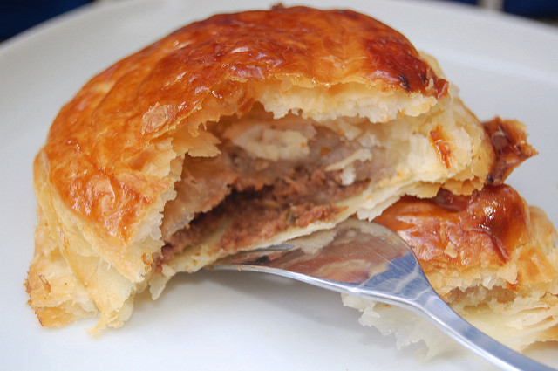

Slide 53
Pastelitos

Slide 54
This creamy Mexican sponge cake highlights three kinds of dairy – evaporate milk, condensed milk, and cream.

Slide 55
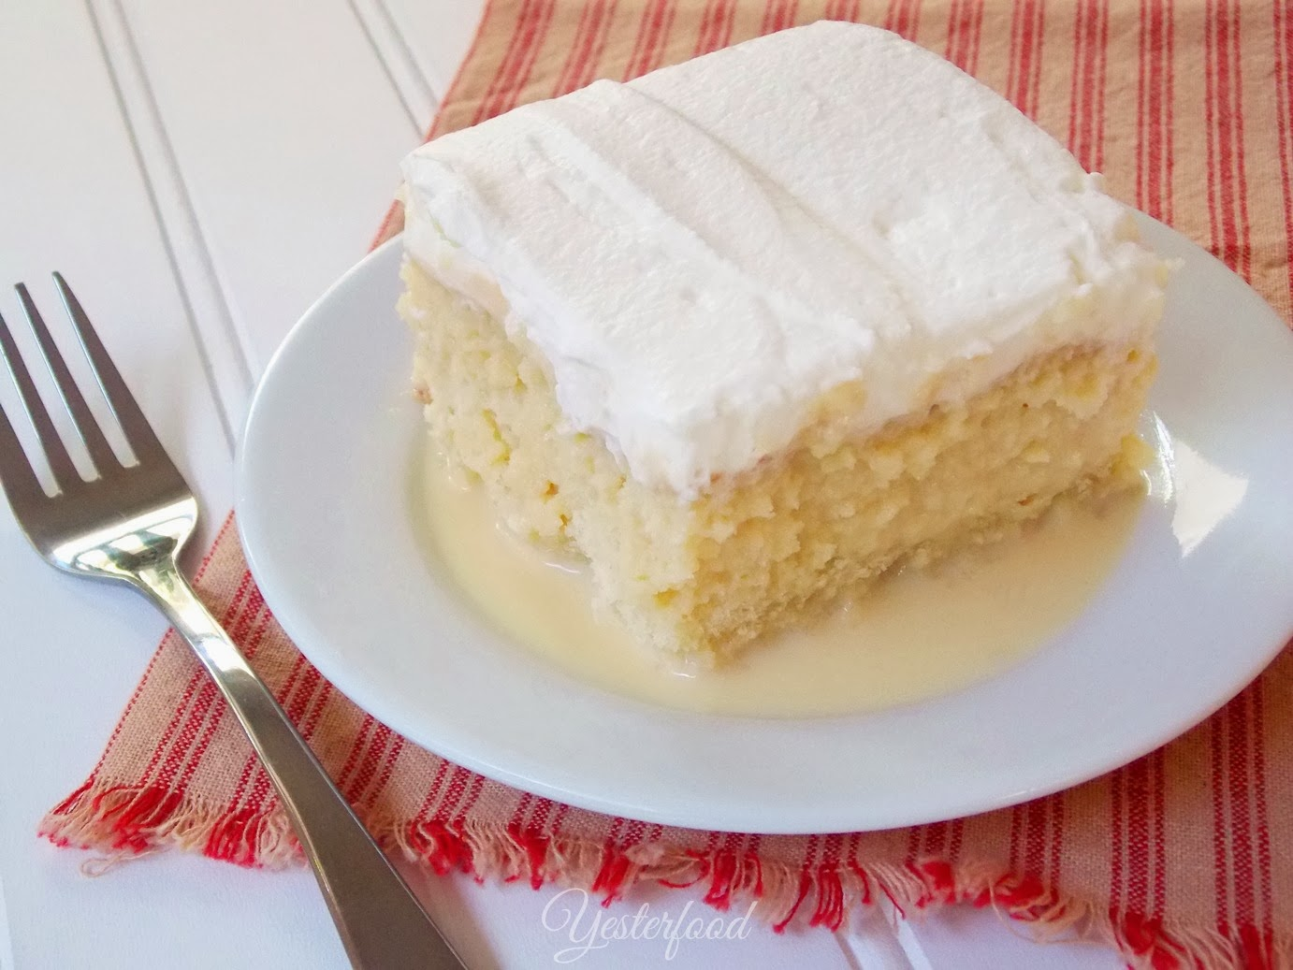

Slide 56
Tres Leches Cake

Slide 57
This German cake is known for its namesake – if not the origin – of the country’s most luscious cake.

Slide 58
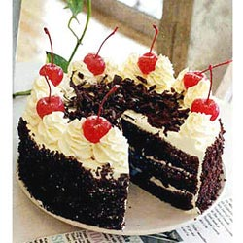

Slide 59
Black Forest Cake

Slide 60
A shattering – crisp shell gives way to a creamy cheese filling in this Sicilian classic.

Slide 61
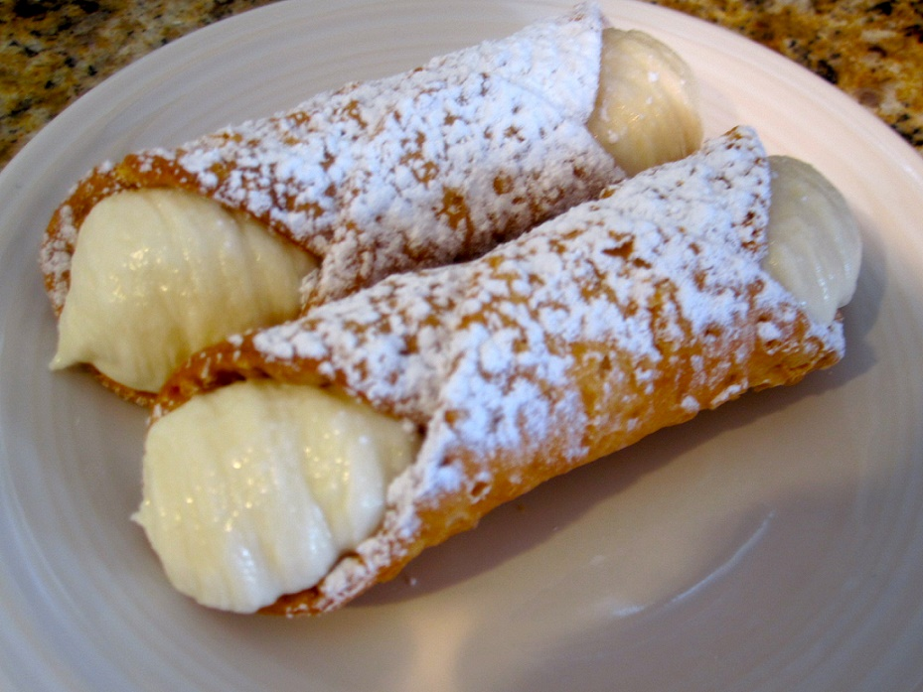

Slide 62
Cannoli

Slide 63
A simple, airy French cocoa confection, this dessert is a delicious paradox: the richer it is, the lighter it seems.

Slide 64
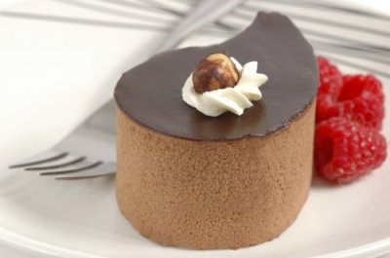

Slide 65
Chocolate Mousse

Slide 66
Bouncy, buttery rounds of vanilla cake are piled high with shredded coconut and seven minute frosting for a classic Southern dessert.

Slide 67
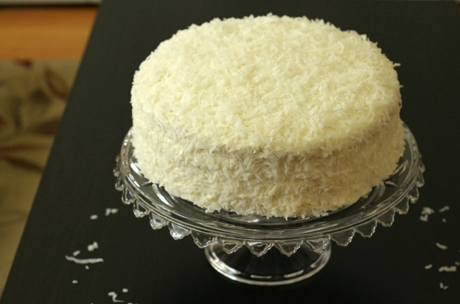

Slide 68
Coconut cake

Slide 69
This traditional fried Chinese treat is often filled with a sweet bean paste or a soft puree made from lotus seeds.

Slide 70
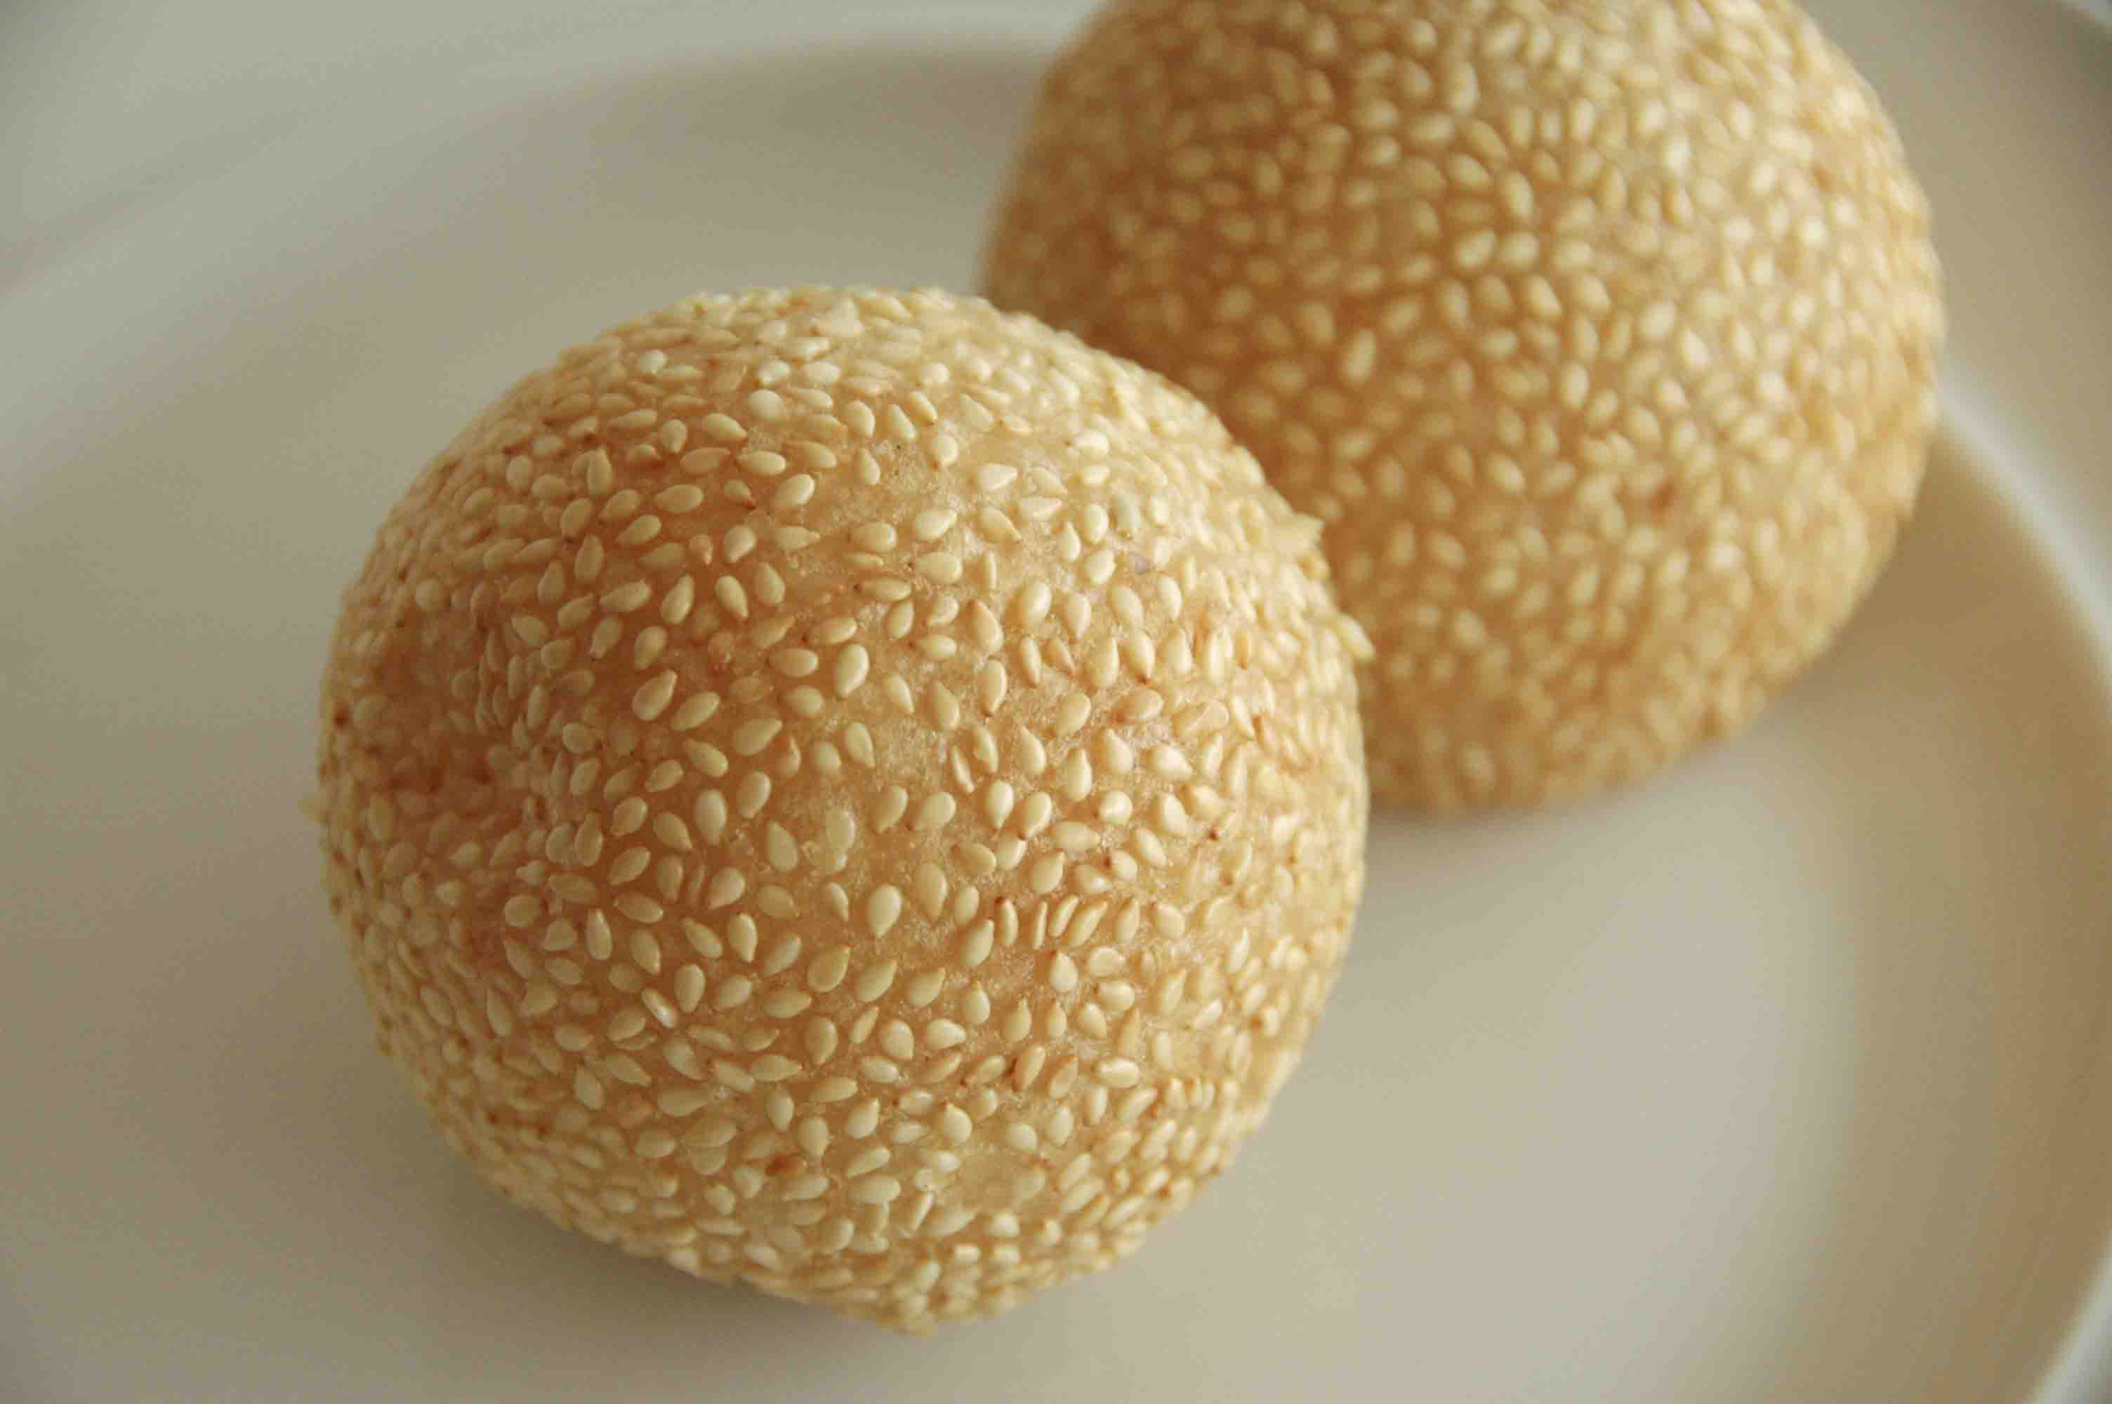

Slide 71
Sesame Balls

Slide 72
This French flipped caramelized treat that has layers of apples, sugar and butter topped off with a round of dough.

Slide 73
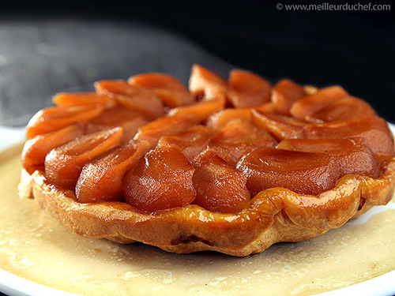

Slide 74
Tarte Tatin

Slide 75
A favorite British dessert with layers of sherry – soaked sponge cake and jam or fruit, with blankets of whipped cream.

Slide 76
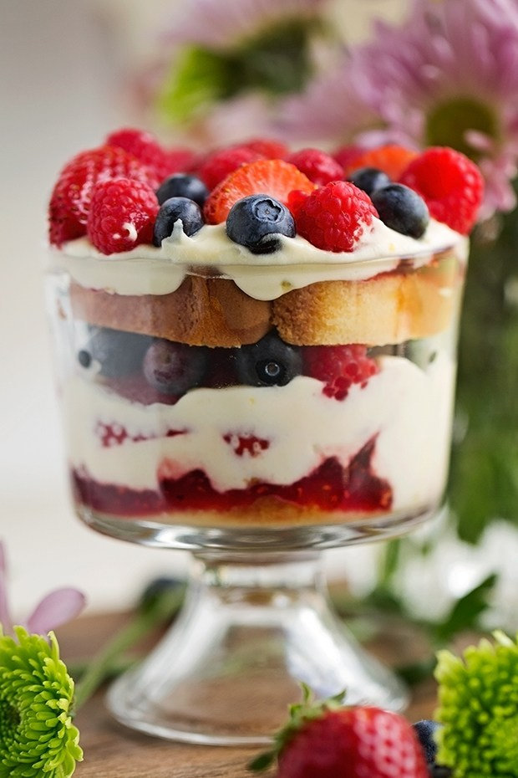

Slide 77
Trifle

Slide 78
Let’s go for Seconds!

Slide 80
Flan

Slide 82
Macaroon

Slide 84
Gelato

Slide 86
Cannoli

Slide 88
Chocolate Mousse

Slide 90
Biscotti

Slide 92
Bread Pudding

Slide 94
Tres Leches Cake

Slide 96
Trifle

Slide 98
Crème brulee

Slide 99
Finished!
Time to Eat!

