Slide 1
Are We There Yet?

Slide 2
Instructions:
Name the State Capital
Name the State
Give the State abbreviation
Name the States largest city

Slide 3
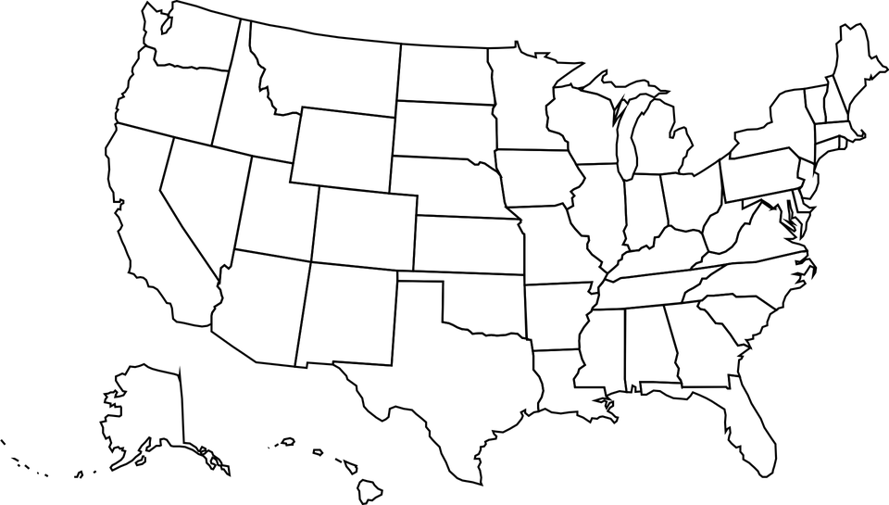

Slide 4
Cheyenne, WY
Cheyenne

Slide 6
Montgomery, AL
Birmingham

Slide 8
Madison, WI
Milwaukee

Slide 10
Juneau, AK
Anchorage

Slide 12
Charleston, WV
Charleston

Slide 14
Phoenix, AZ
Phoenix

Slide 16
Olympia, WA
Seattle

Slide 18
Little Rock, AR
Little Rock

Slide 20
Sacramento, CA
Los Angeles

Slide 22
Richmond, VA
Virginia Beach

Slide 24
Denver, CO
Denver

Slide 26
Montpelier, VT
Burlington

Slide 28
Hartford, CT
Bridgeport

Slide 30
Salt Lake City, UT
Salt Lake City

Slide 32
Dover, DE
Wilmington

Slide 34
Austin, TX
Houston

Slide 36
Tallahassee, FL
Jacksonville

Slide 38
Nashville, TN
Nashville

Slide 40
Atlanta, GA
Atlanta

Slide 42
Pierre, SD
Sioux Falls

Slide 44
Honolulu, HI
Honolulu

Slide 46
Boise, ID
Boise

Slide 48
Columbia, SC
Charleston

Slide 50
Springfield, IL
Chicago

Slide 52
Providence, RI
Providence

Slide 54
Indianapolis, IN
Indianapolis

Slide 56
Harrisburg, PA
Philadelphia

Slide 58
Des Moines, IA
Des Moines

Slide 60
Salem, OR
Portland

Slide 62
Oklahoma City, OK
Oklahoma City

Slide 64
Topeka, KS
Wichita

Slide 66
Columbus, OH
Columbus

Slide 68
Frankfort, KY
Louisville

Slide 70
Bismarck, ND
Fargo

Slide 72
Baton Rouge, LA
New Orleans

Slide 74
Raleigh, NC
Charlotte

Slide 76
Augusta, ME
Portland

Slide 78
Albany, NY
New York City

Slide 80
Annapolis, MD
Baltimore

Slide 82
Santa Fe, NM
Albuquerque

Slide 84
Boston, MA
Boston

Slide 86
Trenton, NJ
Newark

Slide 88
Lansing, MI
Detroit

Slide 90
Concord, NH
Manchester

Slide 92
St. Paul, MN
Minneapolis

Slide 93
,

Slide 94
Carson City, NV
Las Vegas

Slide 96
Jackson, MS
Jackson

Slide 98
Helena, MT
Billings

Slide 100
Lincoln, NE
Omaha

Slide 102
Jefferson City, MO
Kansas City

Slide 103
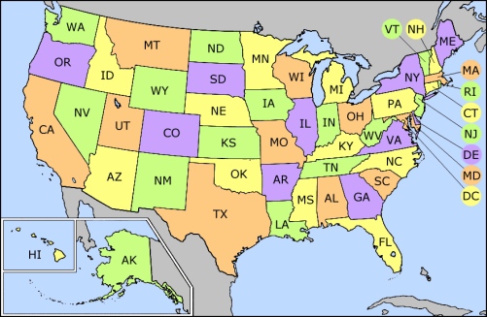

Slide 104
Are we there yet?
The End

