Slide 1
Thumbs Up or Thumbs Down

Slide 2
Thumbs Up if the picture matches the picture previous of the Roman Columns

Slide 3


Slide 4
Thumbs down if the picture does not match the picture previous of the Roman Columns

Slide 6
Keep count of the number of matches throughout the presentation.

Slide 7
Let’s Begin!

Slide 8
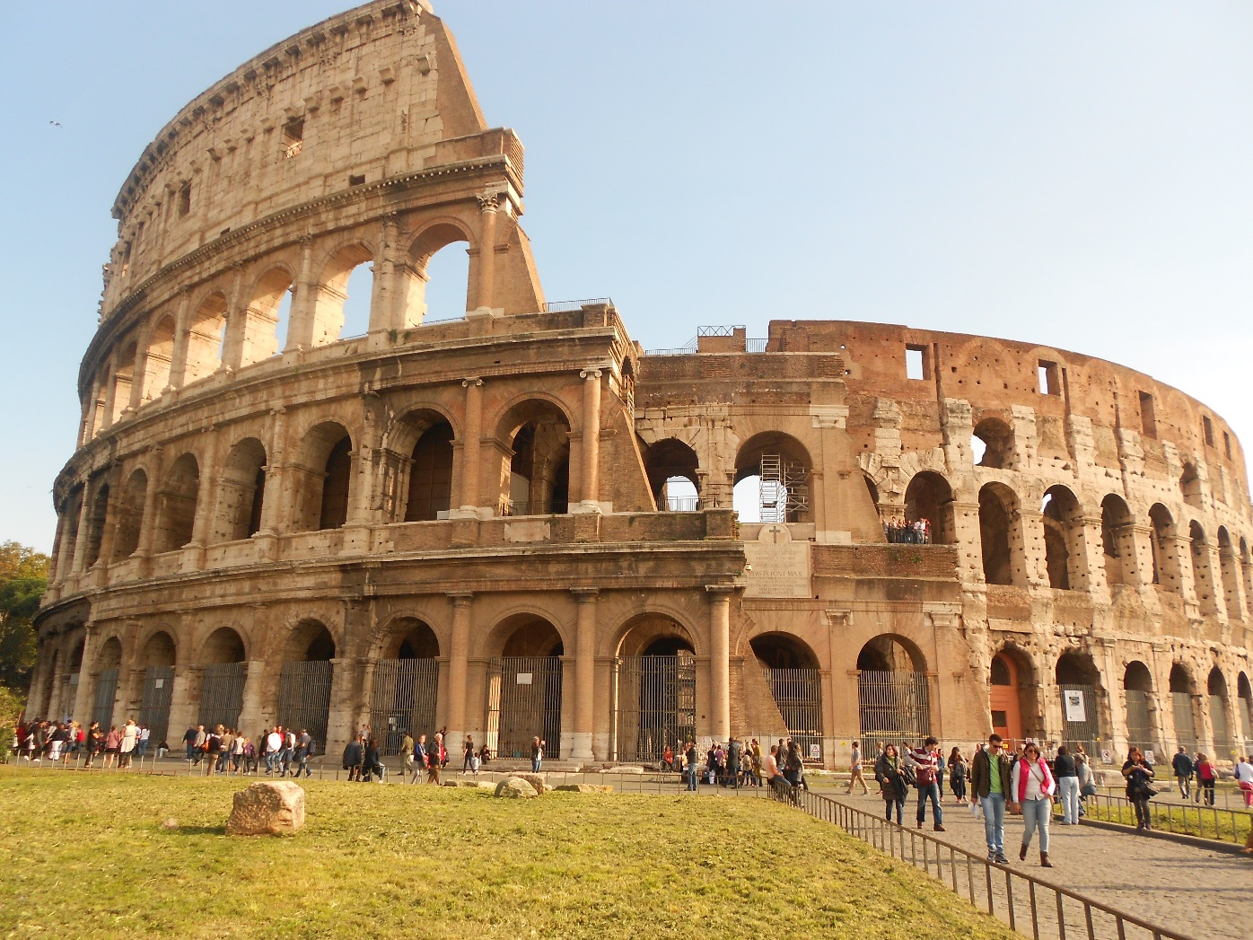
tat

Slide 10
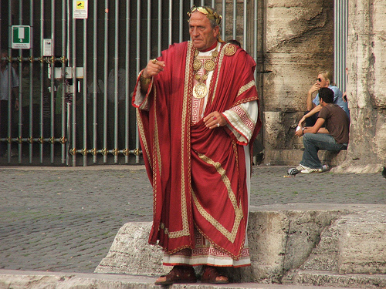

Slide 12
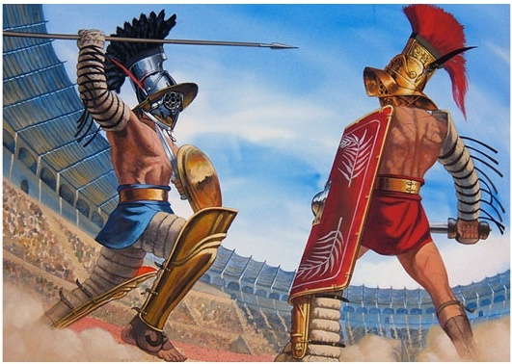

Slide 16
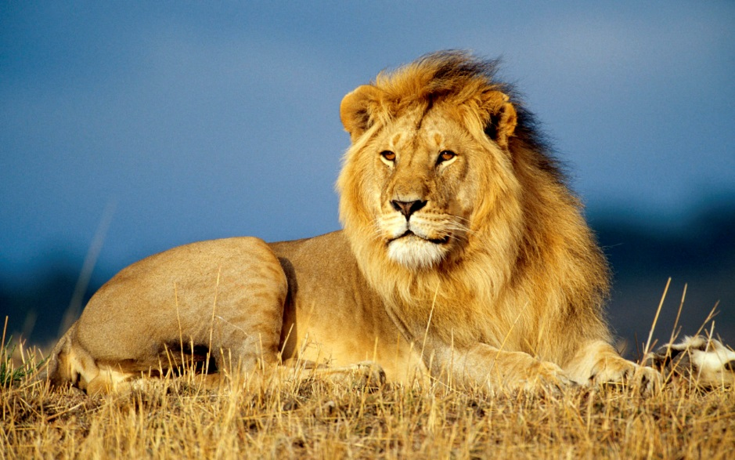

Slide 20
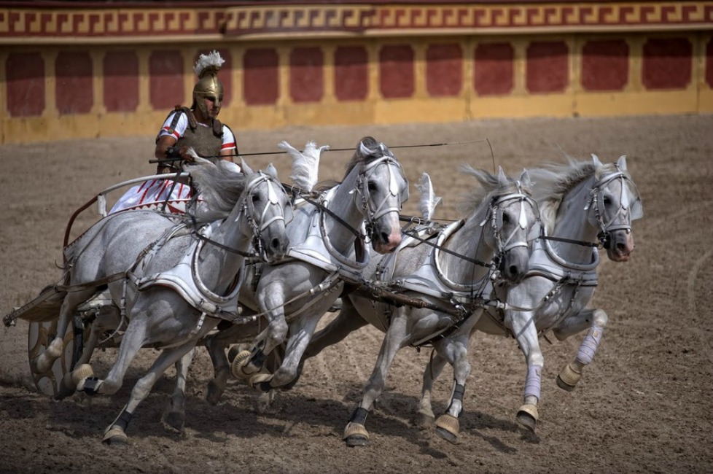

Slide 24
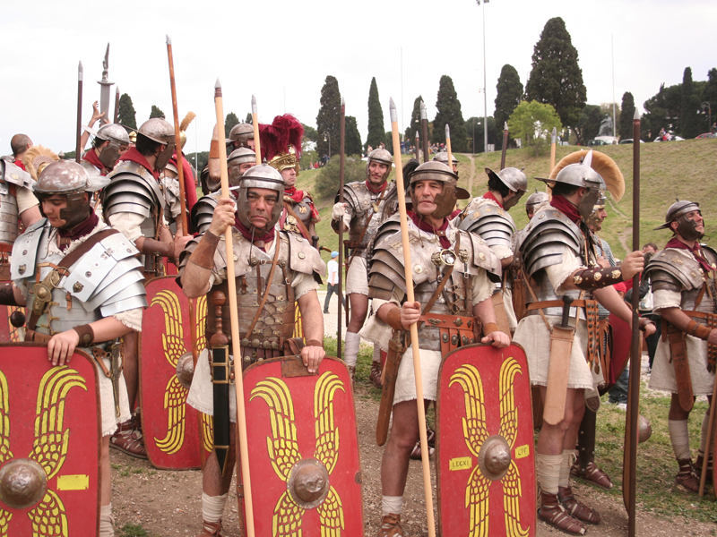

Slide 28
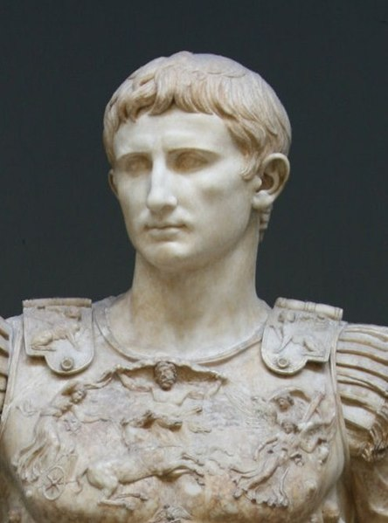

Slide 30
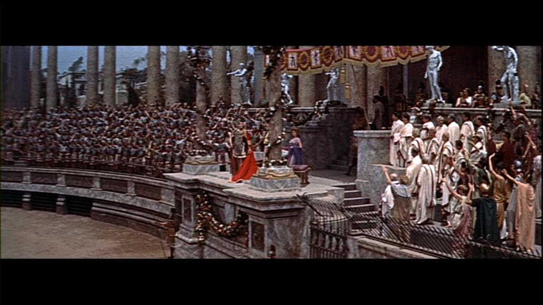

Slide 32
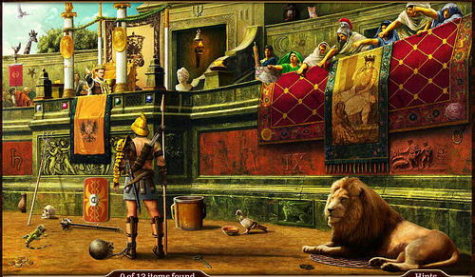

Slide 34
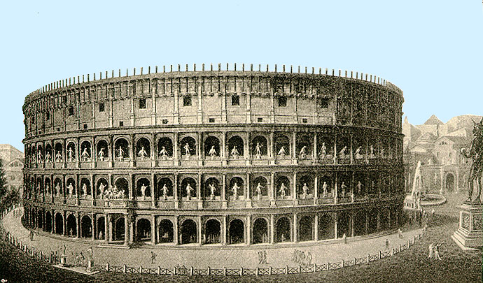

Slide 36
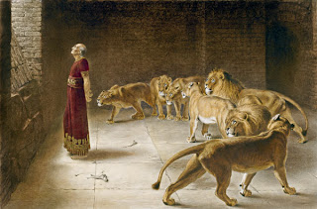

Slide 46
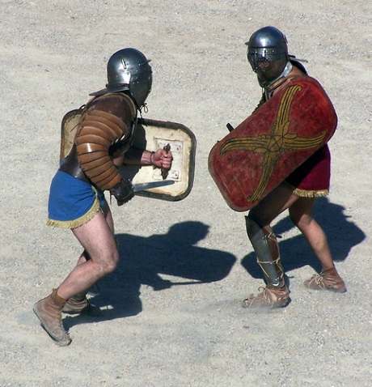

Slide 48
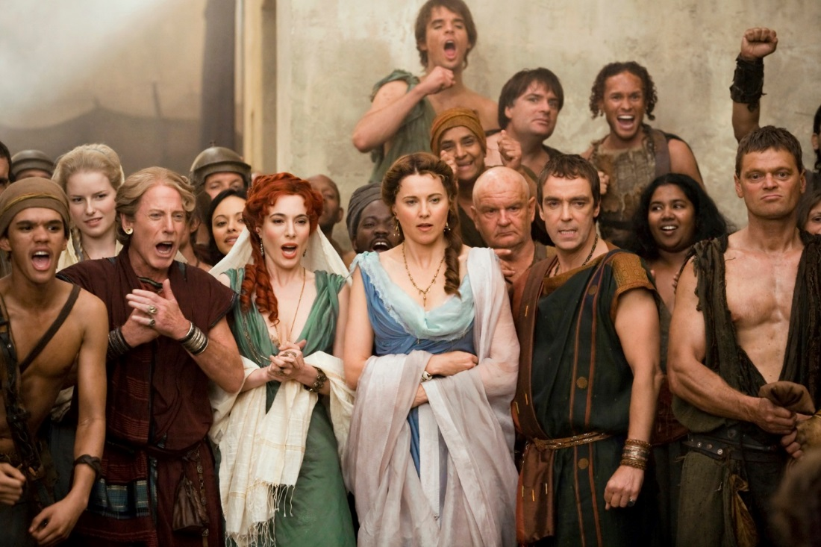

Slide 112
How many matching pictures were there?

Slide 113
How many matching pictures were there?
12

Slide 114
Finis !

